Slide 1
Series: Two
Webinar: Three

Slide 2

Congratulations to our CC influencers!
8th = Winnie VanderBorgh, Julie Harris, Olympia Kallman, Jan Lattie, Christine Taylor
5th = Veronica Davidson, Shelley Jaquet, Eileen Lothian
4th Mark Parsekian

Slide 3
In Third Place…
Sandra Lindeke

Slide 4
In Second Place…
Sandra Barnsley

Slide 5

OUR WINNER IS...
Conscious Giving Hub
Rae Jury and Jane Halliday

Slide 6
Recap: Raise your new IBOs as you would your children
Baby: Nurturing/Dependence
Child: Encouragement/Guidance/Supervision
Young adult: Recognition/Reassurance/Responsibility
Adult: Independence/Contribution

Slide 7
How mentors helped me overcome a fear of rock climbing:
They gave me an opportunity to find out I could do it.
They divided the climb into manageable stages.
They helped me onto the rock, so I was moving before I could overthink the challenge ahead of me.
By helping me succeed at the start they motivated me to keep going.

Slide 8
Give your new IBO the best possible start:
Welcome
Belief
Goal
Commitment (mine and yours!)
Follow the rewards
Shortcuts
Next steps

Slide 9
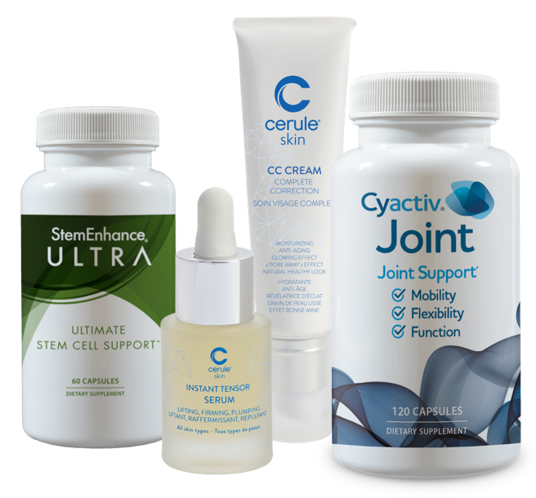
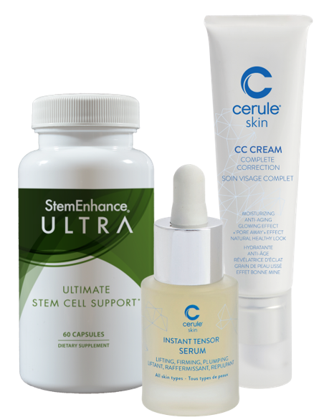
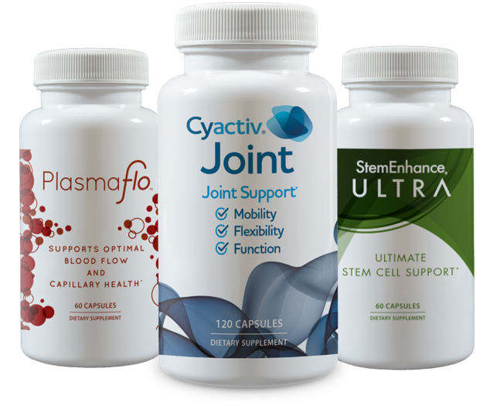

3 and FREE Program
Get 3 preferred customers on ANY wellness pack every month
1
2
3
And your wellness pack AutoShip is FREE the following month!!
FREE
=

Slide 10
Rank Advancement Rewards
Rank | Rank Reward | Fast Track Reward | Time
1K | $50.00 USD | $100.00 USD | 1 Month
3K | $100.00 USD | $300.00 USD | 1 Month
7.5K | $300.00 USD | $750.00 USD | 2 Months
15K | $500.00 USD | $1,500.00 USD | 2 Months
25K | $750.00 USD | $2,500.00 USD | 3 Months
50K | $1,000.00 USD | $5,000.00 USD | 4 Months

Slide 11

Next week:
The Circle of Leadership

